Slide 1

Chad Chess
By Steven Cisneros, Roger Hannigan, Andy Thai, Miles Blaisus, Badr Hashmi

Slide 2
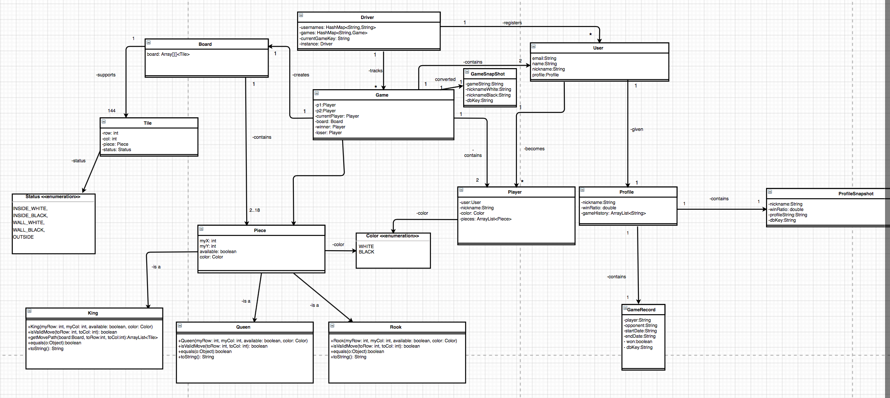
Domain Model Document

Slide 3
Development Manual
Environment
To set up the development environment to work on the project you must have Android Studio. Once you are in Android Studio the IDE will have the project in the left side bar where you can expand the folder and see the individual components that make the project up. To create/import a project you must click on the file tab at the top of the program then choose new. Once you have chosen new you can choose start a new program or import program, if you choose import you must find/browse the directory you have the program stored in. Once you have chosen the program you want to import press OK then it should show on the left side bar. If it does not , refresh the program by pressing F5.
Developer
As a developer to run the system you want to open Android Studio and choose the project on the left hand sidebar. Once you select the project you want to work on you can expand it. When you expand it, it will then show individual packages and then within each package there are the individual classes that you can select to work on. As a developer you must have the correct SDK version installed on the program to work on your android device. If you do not the application will either not install or crash immediately once opened. To prevent this from happening when you plug an android device to test the application a pop up screen will let you know what SDK is installed on the android device and what is needed. If another version is needed it will ask if you would like to install it. Hit accept and the download will commence and install properly where it is needed.
Testing
To run test you must go to the Run tab on the top of the program, then select run… once that is selected you will want to choose the individual class you want to test. Classes within our program that have J-unit testing are under the Backend Package and Testing Package. Within those two packages you can then specifically choose the class you want to test. Program test results will print to console and tell if it passed or did not.

Slide 4
Refactoring / Design Pattern list
Refactoring
Removed a lot of no longer used variables and methods.
Removed no longer used classes.
Changed passing of data elements around using more Android standard implementation i.e. using intents and bundles.
Design Pattern List
Observer
MVC

Slide 5
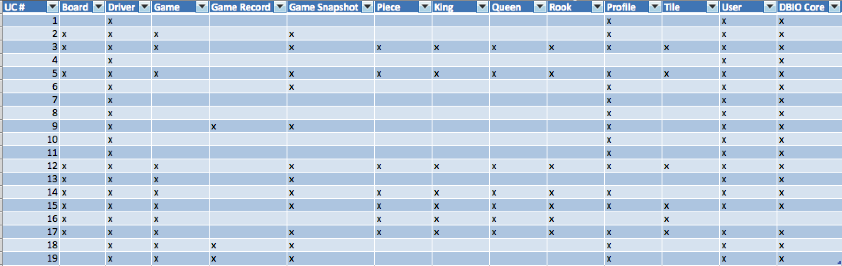
Traceability link Matrix

Slide 6
Challenges and Lessons
Challenges
Lack of experience working with Android Studio
Trouble running the App on different phones
Learning new concepts e.g UI elements, DataBase, Background Threads vs MainUIThread
Getting the game code to work synchronously with User Interface
Lessons
Time Management is key
Coordinating/Dividing work between the members
Plan Early
Use GitHub more effectively( add/close issues).

Slide 7

Demo Time ...

Slide 8
Questions?

